Slide 1
EEE 3207 ELECTRICAL MACHINES 2
LECTURE 1 AND 2

Slide 2
Three Phase Transformers
A three-phase system in used to generate and transmit electric power.
Three phase voltages are raised or lowered by means of three-phase transformers.
A three-phase transformer can be built in two ways viz.,
  by suitably connecting a bank of three single-phase transformers or
  by constructing a three-phase transformer on a common magnetic structure.
In either case, the windings may be connected in Y-Y, Δ - Δ, Y – Δ or Δ -Y.
Y-Wye (Star) & Δ-Delta

Slide 3
One unit 3phase Transformer
A three-phase transformer can be constructed by having three primary and three secondary windings on a common magnetic circuit. The basic principle of a 3-phase transformer is illustrated in Fig. (i).
The three single-phase core type transformers, each with windings (primary and secondary) on only one leg have their unwound legs combined to provide a path for the returning flux.
The primaries as well as secondaries may be connected in star or delta. If the primary is energized from a 3-phase supply, the central limb (i.e., unwound limb) carries the fluxes produced by the 3-phase primary windings.
Since the phasor sum of three primary currents at any instant is zero, the sum of three fluxes passing through the central limb must be zero.
Hence no flux exists in the central limb therefore.

Slide 4
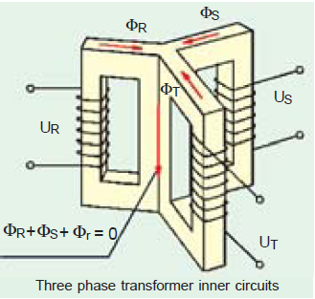
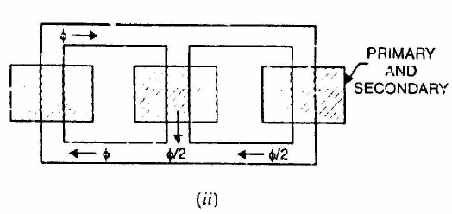
Hence no flux exists in the central limb and it may, therefore, be eliminated.
This modification gives a three leg core type 3-phase transformer.
In this case, any two legs will act as a return path for the flux in the third leg. {Fig ii} Eg, if flux is φ in one leg at some instant, then flux is φ/2 in the opposite direction through the other two legs at the same instant
All the connections of a 3-phase transformer are made inside the case and for delta-connected winding three leads are brought out while for star connected winding four leads are brought out.

Slide 5
Advantages of 3 phase transformers
For the same capacity, a 3-phase transformer weighs less, occupies less space and costs about 20% less than a bank of three single-phase transformers.
Because of these advantages, 3-phase transformers are in common use, especially for large power transformations.
A disadvantage of the three-phase transformer lies in the fact that when one phase becomes defective, the entire three-phase unit must be removed from service.
When one transformer in a bank of three single-phase transformers becomes defective, it may be removed from service and the other two transformers may be reconnected to supply service on an emergency basis until repairs can be made.
There is little difference in reliability, but it is cheaper to carry spare stock of a single-phase rather than a three-phase transformer. In underground use (mines) a bank of single-phase units may be preferred as it is easier to transport these units.

Slide 6
Three-Phase Transformer Connections
The primary or secondary windings may be connected in either star (Y) or delta (Δ) arrangement.
The four most common connections are:
  Y-Y
  Δ-Δ
  Y-Δ
  Δ-Y.
These four connections are shown in figures below.
In these figures, the windings at the left are the primaries and those at the right are the secondaries.
The primary and secondary voltages and currents are also shown.
The primary line voltage is (V) and the primary line current is (I).
The phase transformation ratio is K (N₂/N₁)

Slide 7
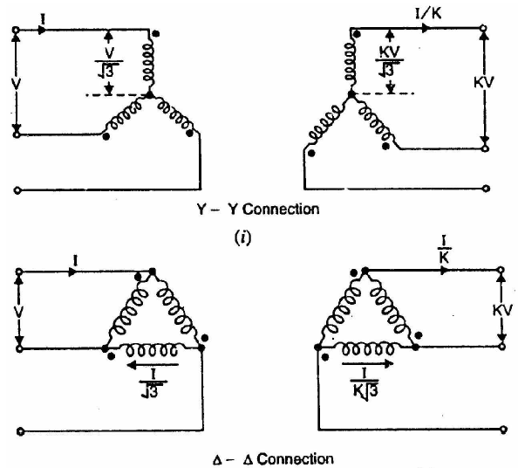
Three-Phase Transformer Connections

Slide 8
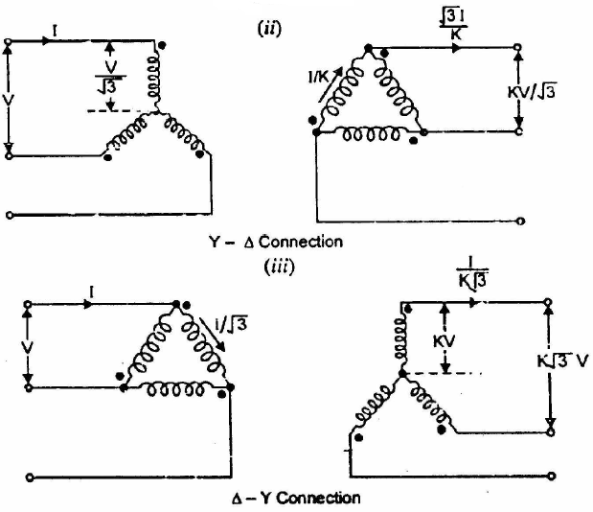
Three-Phase Transformer Connections

Slide 9
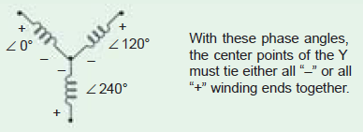
Y-Y Connection
More economical because number of turns/phase and the amount of insulation required is minimum.
In the Y-Y connection shown in Fig. (i), 57.7% (or 1/ √3) of the line voltage is impressed upon each winding but full line current flows in each winding.
Power circuits supplied from a Y-Y bank often create serious disturbances in communication circuits in their immediate vicinity. Also works with balanced loading.
Because of this and other disadvantages, the Y-Y connection is seldom used.

Slide 10
Δ-Δ Connection.
The Δ-Δ connection shown in Fig. (ii) is often used for moderate voltages.
An advantage of this connection is that if one transformer gets damaged or is removed from service, the remaining two can be operated in what is known as the open-delta or V-V connection.
By being operated in this way, the bank still delivers three-phase currents and voltages in their correct phase relationships but the capacity of the bank is reduced to 57.7% of what it was with all three transformers in service.
No difficulty is experienced when exposed to unbalanced loading.

Slide 11
Combined connections
Y-Δ Connection.
The Y-Δ connection shown in Fig. (iii) is suitable for stepping down a high voltage.
In this case, the primaries are designed for 57.7% of the high-tension line voltages.
Δ-Y Connection.
The Δ-Y connection shown in Fig. (iv) is commonly used for stepping up to a high voltage.

Slide 12
Practice Question
Qn. A 3-phase 50Hz transformer has a delta- connected primary and star-connected secondary, the line voltages being 22kV and 0.4kV, respectively. The secondary has a star connected balanced load at 0.8pf lagging. The line current on the primary side is 5A. Determine the current in each coil of the primary and in each secondary line. Also calculate the output real power of the transformer

Slide 13
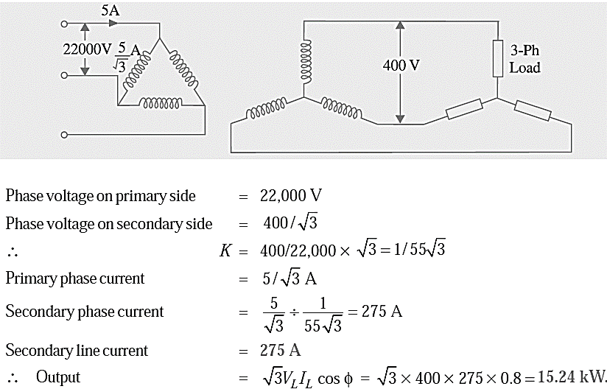
Solution

Slide 14
Vector Group of 3-phase transformer
The secondary voltages of a 3-phase transformer may undergo a phase shift of either +30º leading or -30º lagging or 0º i.e, no phase shift or 180º reversal with respective line or phase to neutral voltages.
On the name plate of a three phase transformer, the vector group is mentioned.
Typical representation of the vector group could be Ydl or Dy11 etc.
The first capital latter Y indicates that the primary is connected in star and the second lower case latter d indicates delta connection of the secondary side.
The third numerical figure conveys the angle of phase shift based on clock convention.
The minute hand is used to represent the primary phase to neutral voltage and always shown to occupy the position 12.
The hour hand represents the secondary phase to neutral voltage and may, depending upon phase shift, occupy position other than 12 as shown in the figure (i). The angle between two consecutive numbers on the clock is 30°.

Slide 15
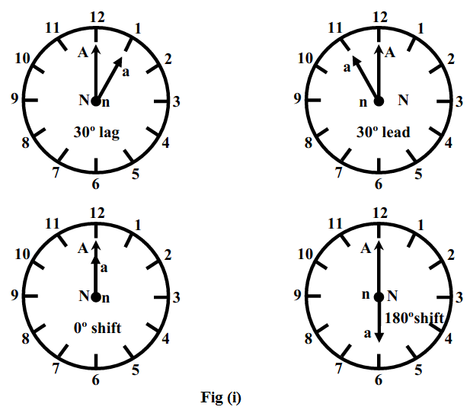
Clock convention representing vector groups

Slide 16
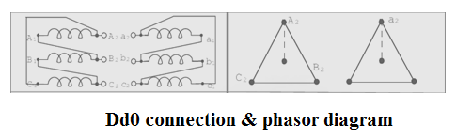
Delta/delta (Dd0, Dd6) connection
The connection of Dd0 is shown in Fig. 1 and the voltages on primary and secondary sides is also shown on the phasor diagram.
The phase angle difference between the phase voltage of high voltage side and low voltage side is zero degree (0º).

Slide 17
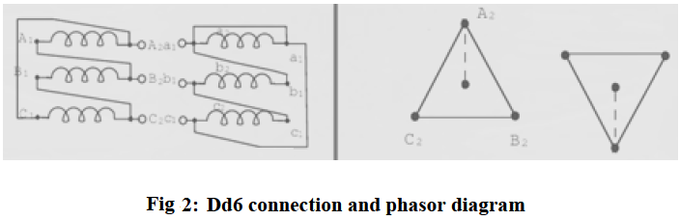
Delta/delta (Dd6) connection
The connection of Dd6 is shown in Fig. 2 and the voltages on primary and secondary sides is also shown on the phasor diagram.
The phase angle difference between the phase voltage of high voltage side and low voltage side is 180º.

Slide 18
This connection proves to be economical for large low voltage transformers as it increases number of turns per phase.
Primary side line voltage is equal to secondary side line voltage.
Primary side phase voltage is equal to secondary side phase voltage.
There is no phase shift between primary and secondary voltages for Dd0 connection.
There is 180º phase shift between primary and secondary voltages for Dd6 connection.

Slide 19
Advantages
Sinusoidal Voltage at Secondary: In order to get secondary voltage as sinusoidal, the magnetizing current of transformer must contain a third harmonic component.
The delta connection provides a closed path for circulation of third harmonic component of current.
The flux remains sinusoidal which results in sinusoidal voltages.
Suitable for Unbalanced Load: Even if the load is unbalanced the three phase voltages remains constant.
Thus it suitable for unbalanced loading also.
Carry 58% Load if One Transfer is Faulty in Transformer Bank: If there is bank of single phase transformers connected in delta-delta fashion and if one of the transformers is disabled then the supply can be continued with remaining two transformers of course with reduced efficiency.

Slide 20
advantages
No Distortion in Secondary Voltage: there is no any phase displacement between primary and secondary voltages.
There is no distortion of flux as the third harmonic component of magnetizing current can flow in the delta connected primary windings without flowing in the line wires thus there is no distortion in the secondary voltages.
Economical for Low Voltage: Due to delta connection, phase voltage is same as line voltage hence winding have more number of turns. But phase current is (1/√3) times the line current. Hence the cross-section of the windings is very less. This makes the connection economical for low voltages transformers.
Reduce Cross section of Conductor: The conductor is required of smaller cross section as the phase current is 1/√3 times of the line current. It increases number of turns per phase and reduces the necessary cross sectional area of conductors thus insulation problem is not present.

Slide 21
Disadvantages
Due to the absence of neutral point it is not suitable for three phase four wire system.
More insulation is required and the voltage appearing between windings and core will be equal to full line voltage in case of earth fault on one phase.
Application
Suitable for large, low voltage transformers.
This Type of Connection is normally uncommon but used in some industrial facilities to reduce impact of SLG faults on the primary system
It is generally used in systems where it need to be carry large currents on low voltages and especially when continuity of service is to be maintained even though one of the phases develops fault.

